Slide 1
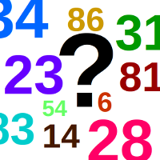
Guees the number
Alessandro Mazzoni

Slide 2
Game rules
Guess the number of the computer
1. Choose the number of guesses
2. Choose a number
3. Computer will give you an hint
4. guess the next number
you win by finding the number,
you loose by using all your guess without finding the number

Slide 3
Challenge
Add other functionality in your code
Correct error
Learn that it can take longer then expected to improve the code
Elements to improve
Create a function that redirect the player if he choose a string instead of a number
add the possibility to try again in case of a wrong input Improve the efficiency of the code
Improve the efficiency of the code

Slide 4
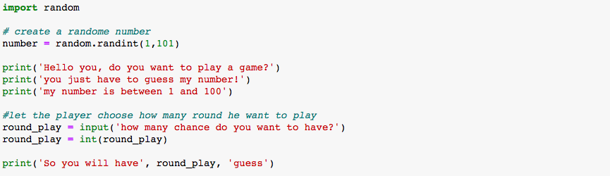
My code part 1

Slide 5
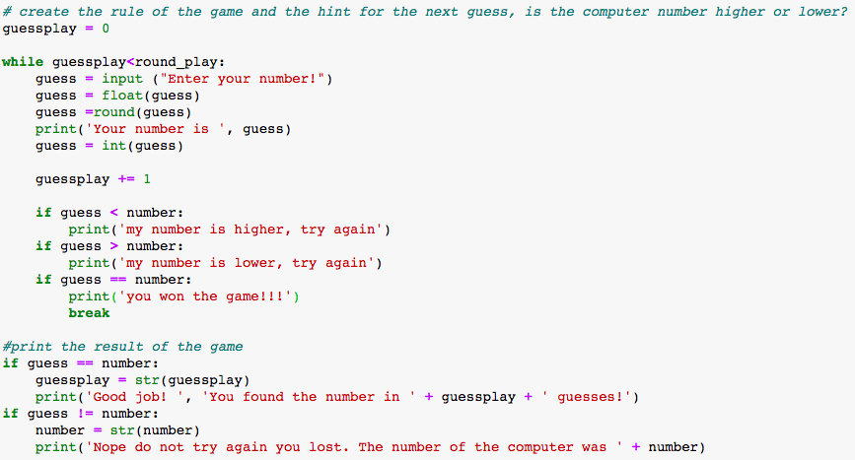
My code part 2

Slide 6
Link to play the code
http://localhost:8889/notebooks/Downloads/mini-project-1-master/your-project/mini%20project%20guess%20a%20number.ipynb

